Slide 1


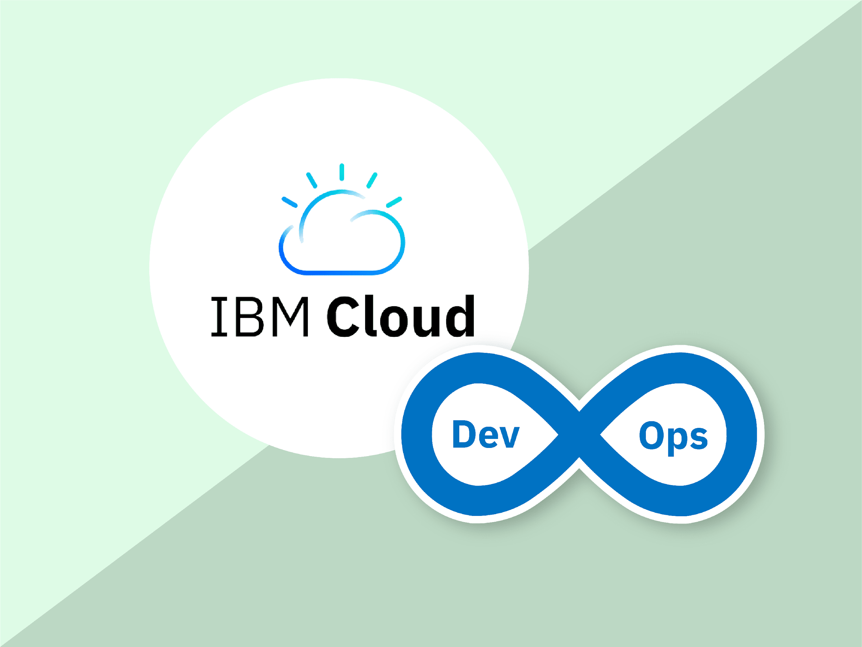
IBM Cloud DevOps
Team 3
Chaitanya Subhash
Srinija
Swaroop
Viswanth
Priyanka

Slide 2


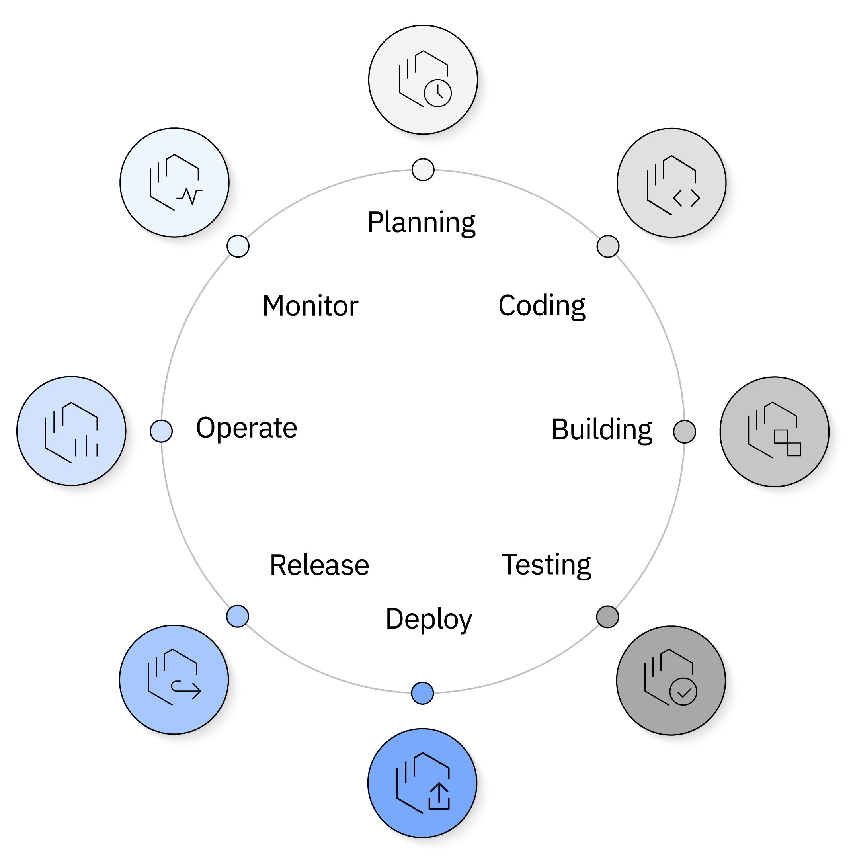
DevOps
Accelerating Innovation & Automation
Automate – Faster, reliable releases with CI/CD.
Collaborate – Bridge the gap between Dev & Ops.
Optimize – Boost performance & resource efficiency.
Secure – Embed security at every stage (DevSecOps).
Impact on IT Operations:
Faster app delivery 🚀
Higher reliability & stability 🔄
Cost & efficiency gains 💰
Stronger security posture 🔒

Slide 3
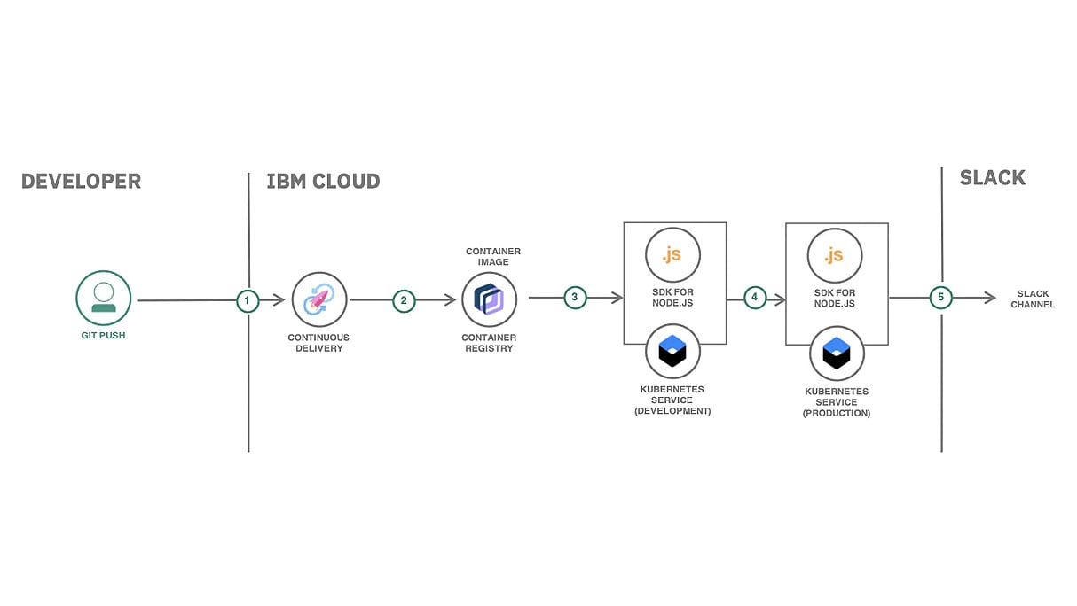
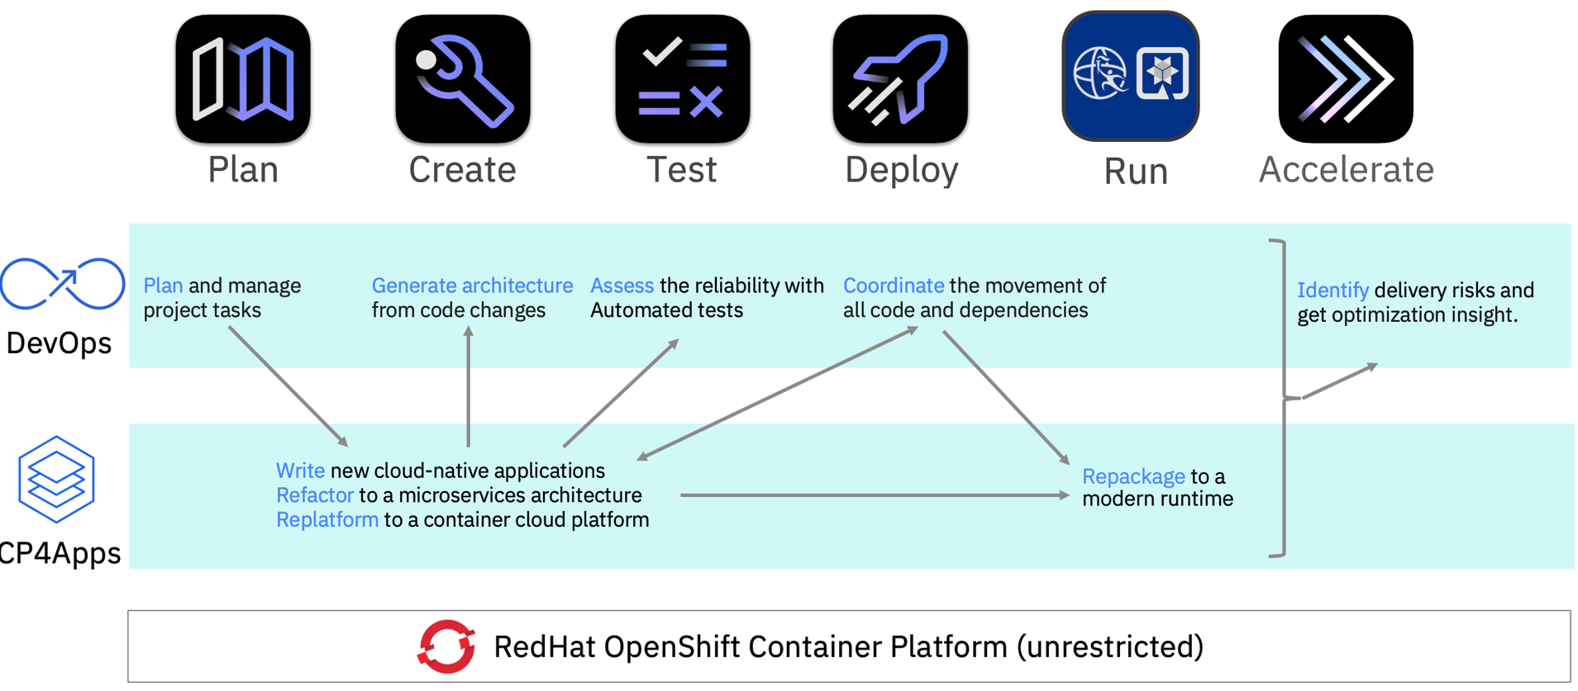
IBM Cloud DevOps
A cloud-native DevOps approach for IBM Cloud.
Automatic continuous integration (CI) & continuous delivery (CD) workflows.
Uses AI-driven automation, monitoring, and security tools.
Supports hybrid & multi-cloud environments.
IBM DevOps automation creates a better software delivery experience.

Slide 4
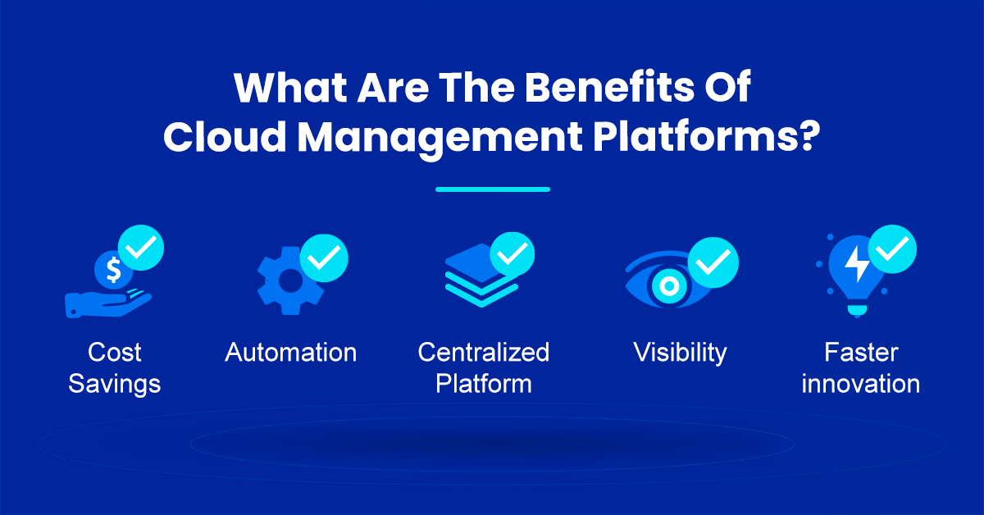
Benefits of IBM Cloud DevOps
Faster Time-to-Market
Cost Efficiency
Scalability & Flexibility
Enhanced Security
Real-Time Monitoring
Notes:
Faster Time-to-Market – IBM Cloud DevOps automates CI/CD pipelines, enabling rapid application development, testing, and deployment. This speeds up software releases and reduces time-to-market.
Cost Efficiency – By leveraging IBM Cloud services, organizations can optimize infrastructure costs, reduce manual efforts, and improve resource utilization. Pay-as-you-go models further enhance cost savings.
Scalability & Flexibility – IBM Cloud’s scalable architecture supports dynamic workloads, allowing teams to adapt to changing demands effortlessly. Kubernetes and OpenShift further enhance containerized deployments.
Enhanced Security – IBM integrates security best practices into DevOps workflows, offering built-in security tools like vulnerability scanning, compliance monitoring, and access controls to ensure robust application security.
Real-Time Monitoring – IBM Cloud DevOps provides advanced monitoring and logging tools, such as Instana and Log Analysis, which help track system health, detect anomalies, and enhance performance.

Slide 5
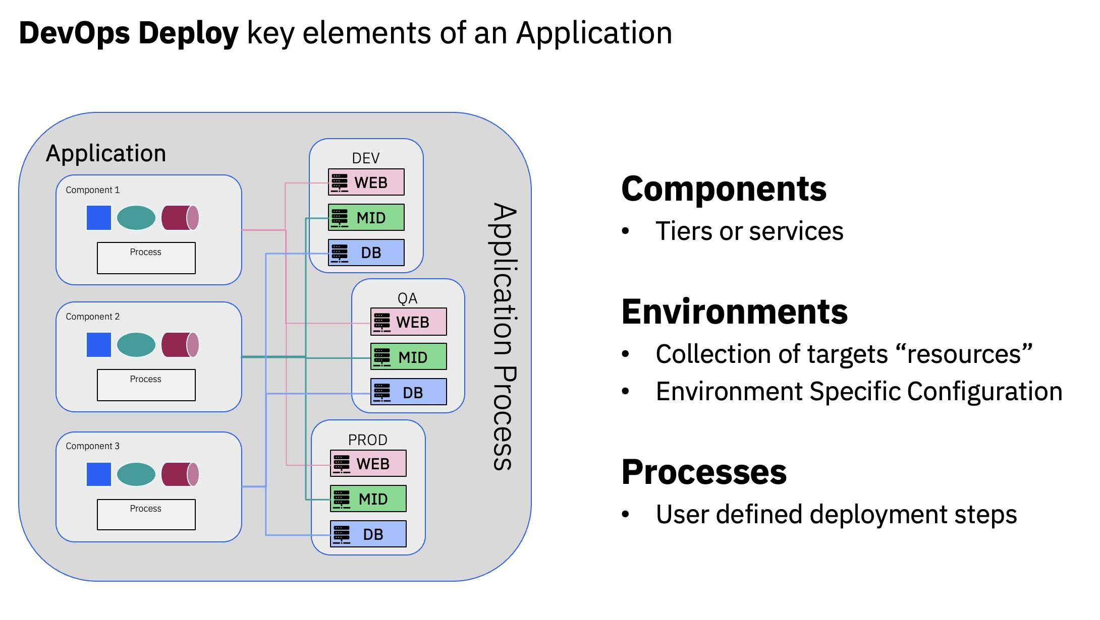
IBM Cloud DevOps Key Tools & Services
IBM Cloud Continuous Delivery
IBM Cloud Kubernetes Service
Red Hat OpenShift on IBM Cloud
IBM Cloud Code Engine
IBM Cloud Log Analysis & Monitoring

Slide 6

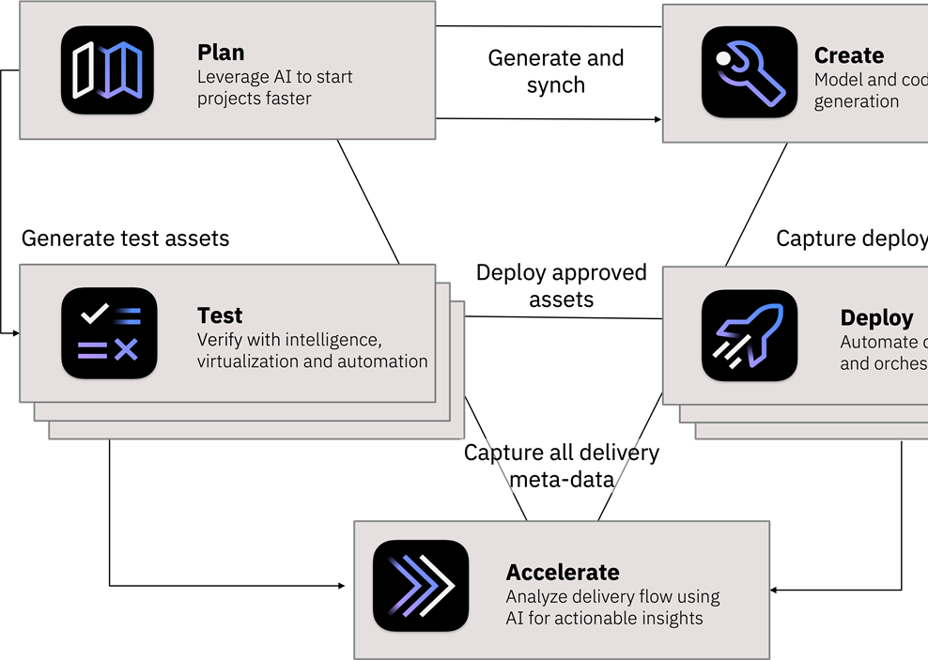
Why Choose IBM Cloud DevOps?
AI-Powered Automation
Seamless Integration
Enterprise-Grade Security
Scalable & Flexible
Proven Industry Use Cases
Notes:
*Why Choose IBM Cloud DevOps?* IBM Cloud DevOps is a robust and efficient solution for modern software development. Here’s why it stands out: 1. *AI-Powered Automation: IBM Cloud DevOps uses **artificial intelligence* to automate critical processes like testing, monitoring, and deployment. This reduces the manual effort required and speeds up the development cycle, allowing teams to focus on more strategic tasks. 2. *Seamless Integration: With IBM Cloud DevOps, you can easily integrate with popular development tools like **Jenkins, **Kubernetes, and **GitHub*. This makes it easier for teams to adopt DevOps practices without disrupting their existing workflows. 3. *Enterprise-Grade Security: Security is built into the platform, with **compliance features, **encryption, and **real-time threat detection*. This ensures your applications and data are always protected, which is critical for businesses dealing with sensitive information. 4. *Scalable and Flexible: IBM Cloud DevOps is designed to grow with your business. Whether you're building a small application or managing large-scale enterprise systems, the platform is **highly scalable* and adaptable to your needs. 5. *Proven Industry Use Cases: IBM Cloud DevOps has been adopted across various industries like **finance, healthcare, and retail*. Its proven track record in delivering reliable, high-performance applications makes it a trusted choice for businesses around the world. In short, IBM Cloud DevOps provides a powerful, secure, and flexible platform that helps companies automate, integrate, and scale their development processes efficiently. Whether you're a small startup or a large enterprise, it can help you stay ahead in today’s fast-paced, competitive environment.

Slide 7
Thank you

